Slide 1

DESIGN THINKING – 22MCA27L
TOPIC: Revamp Lifestyle and Conduct of Labourers
Phase I – Presentation
Members:
Priyanka SP- 1RV22MC074
Neha Gaharwar- 1RV22MC057
Chamundeshwari- 1RV22MC024

Slide 2

Selection of topic of societal concern:
TOPIC: Revamp Lifestyle and Conduct of Labourers
Mapping Topic with Sustainable Development Goals
a. No Poverty (SDG 1):
By enhancing the lifestyle of laborers, you contribute to reducing poverty levels as they are often part of low-income groups.
b. Zero Hunger (SDG 2):
Improving laborers' lifestyle can help ensure they have access to nutritious food, addressing hunger and malnutrition.
c. Good Health and Well-being (SDG 3):
Enhancing laborers' living conditions and providing access to healthcare can improve their overall health and well-being.

Slide 3
d. Quality Education (SDG 4):
By focusing on laborers' well-being, you create conditions for their children to have better opportunities for quality education and break the cycle of poverty.
e. Gender Equality (SDG 5):
Improving laborers' lifestyle should also consider gender equity, ensuring both male and female laborers have equal access to benefits and opportunities.
2. Deciding on forming the team
To form our team of 3 members focused on improving the lifestyle of laborers, we initially conducted a thorough assessment of each member's skills, expertise, and strengths. We ensured a diverse skill set that included project management, communication, and domain knowledge related to laborer's needs. We also considered each member's passion for the cause and commitment to making a positive impact. Through open discussions and aligning our goals, we formed a cohesive team ready to address the challenges and drive meaningful change for laborers' well-being.

Slide 4
Deciding on selection of problem statement
Selecting the problem statement of improving the lifestyle of labor was driven by several factors. Firstly, laborers form an essential backbone of our society, often working in demanding and physically strenuous jobs to contribute to economic growth. However, they often face challenges such as inadequate housing, limited access to healthcare, and insufficient wages.
Recognizing the importance of these individuals and their well-being, we decided to address this issue to create a positive impact on their lives. By focusing on improving their living conditions, providing better healthcare facilities, and advocating for fair wages, we aim to create a more inclusive and compassionate society that values the contributions of all its members.
Furthermore, this problem statement aligns with broader societal goals of reducing inequality, promoting human rights, and fostering a sense of social responsibility. By addressing the challenges faced by laborers, we can work towards creating a more just and balanced society that values the dignity and well-being of every individual.

Slide 5
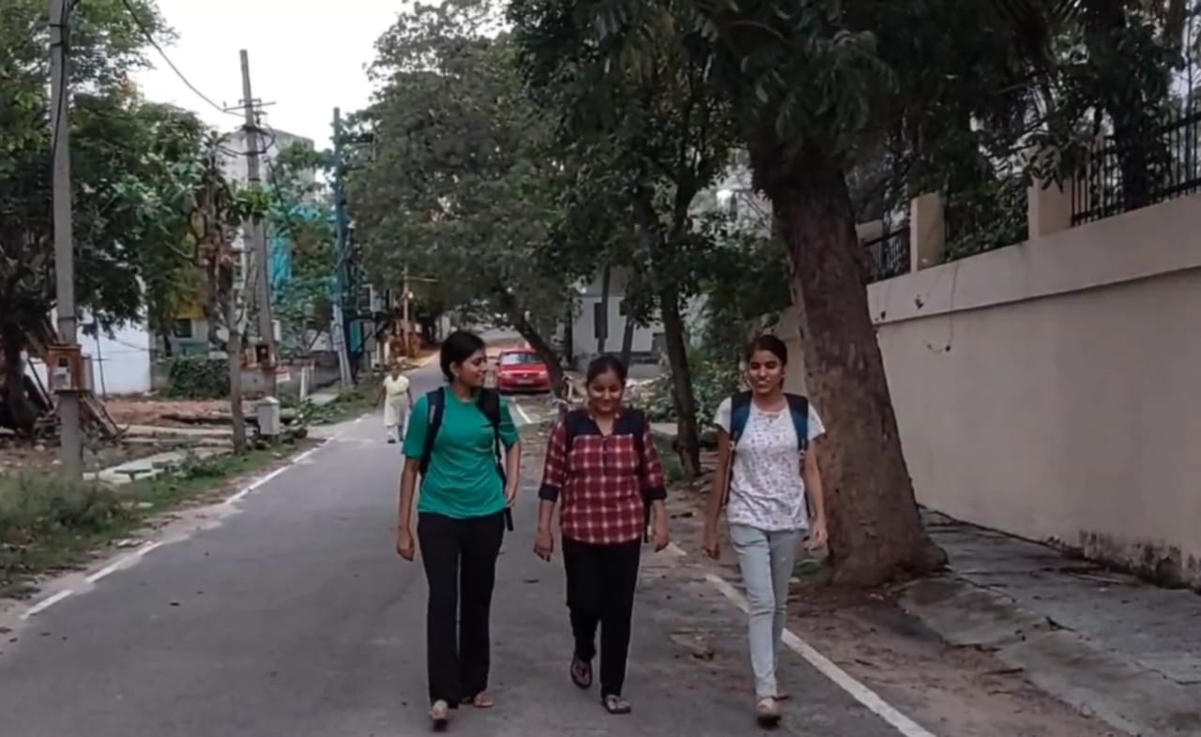
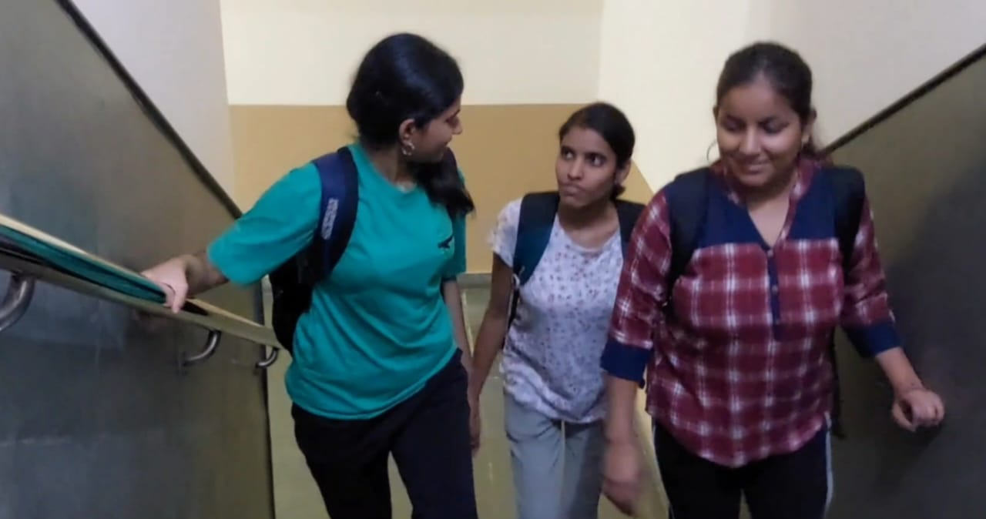

Slide 6
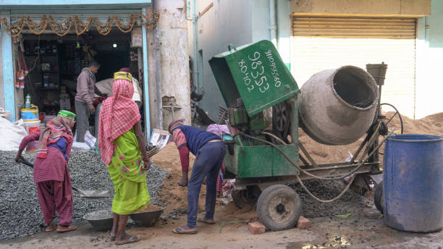
User Persona and Research:
On-site Observations
Onsite observation from a laborer's point of view involves being physically present at a construction or work site to perform various tasks. This can include tasks such as manual labor, operating machinery, following instructions from supervisors, and collaborating with other team members. Laborers often deal with the practical aspects of construction, maintenance, or other projects, and their observations can provide valuable insights into the progress, challenges, and safety concerns of the project. Being on-site allows laborers to directly experience the conditions, work environment, and dynamics of the project, which helps them contribute effectively to the overall success of the task at hand.

Slide 7
b. Lifestyle
The lifestyle of laborers can vary greatly depending on factors such as their occupation, location, and socio-economic conditions. Generally, laborers often engage in physically demanding work, typically involving manual tasks in industries like construction, agriculture, manufacturing, and more. They may work long hours, sometimes in challenging conditions, and earn wages that may be lower than average. Laborers may have limited access to benefits such as healthcare, job security, and paid leave. Their living conditions might be modest, and they may reside in areas with lower standards of infrastructure and amenities. Social and recreational opportunities could also be limited due to their demanding work schedules.
c. Work Environment
Indian laborers often face challenging work environments characterized by poor working conditions, low wages, long hours, and limited job security. Many work in sectors like agriculture, construction, manufacturing, and informal services. They may lack access to proper safety equipment, sanitation facilities, and adequate housing. Issues like overcrowding, exposure to hazardous substances, and physically demanding tasks contribute to health risks. Additionally, some laborers are subject to exploitation, unfair treatment, and lack of legal protections.

Slide 8
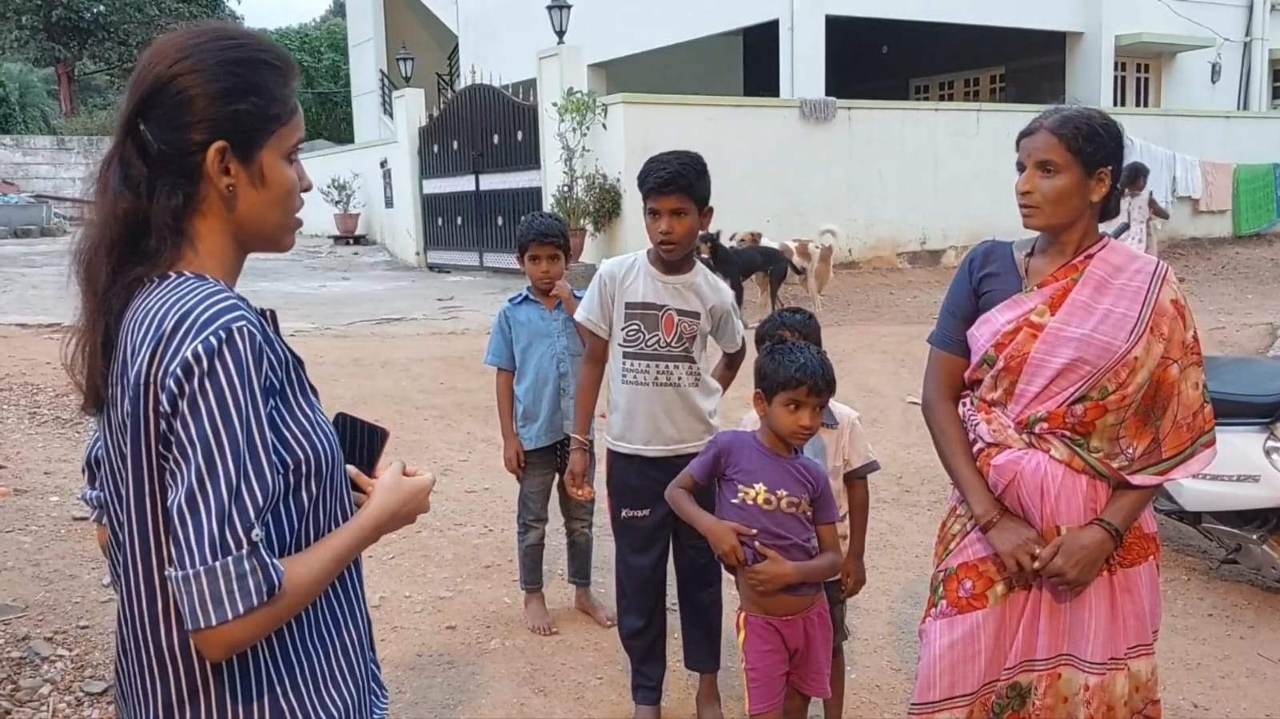
Tools:
a. Focused Group Interviews

Slide 9
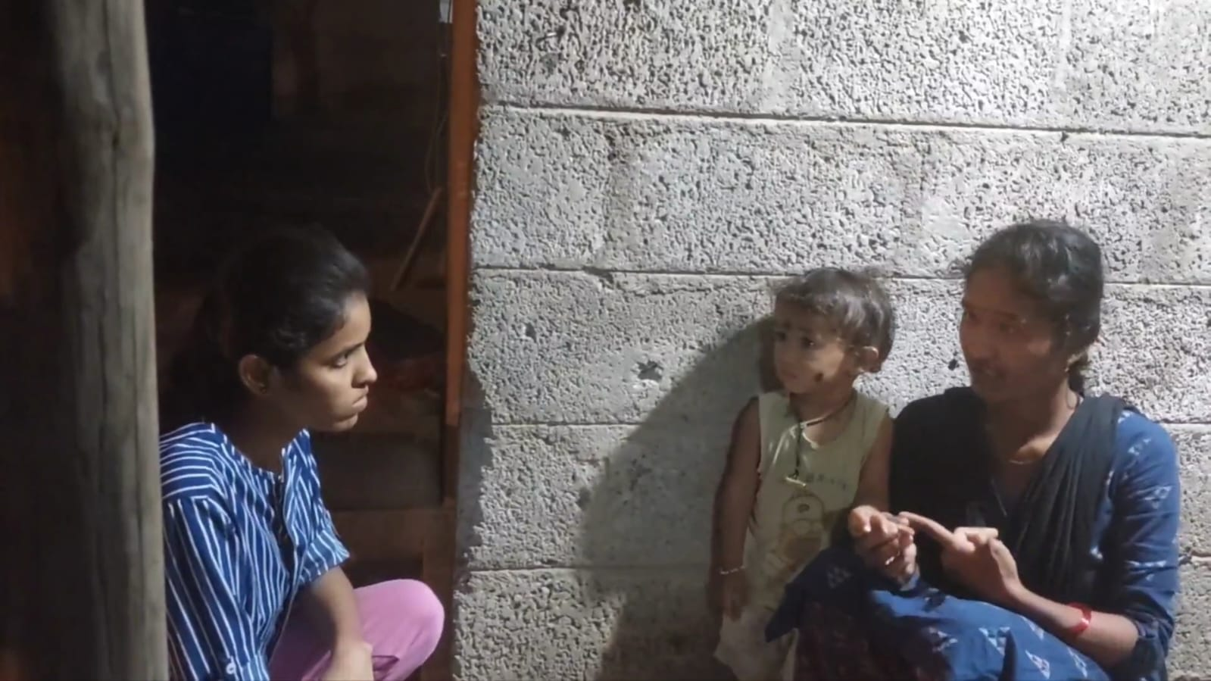

Slide 10
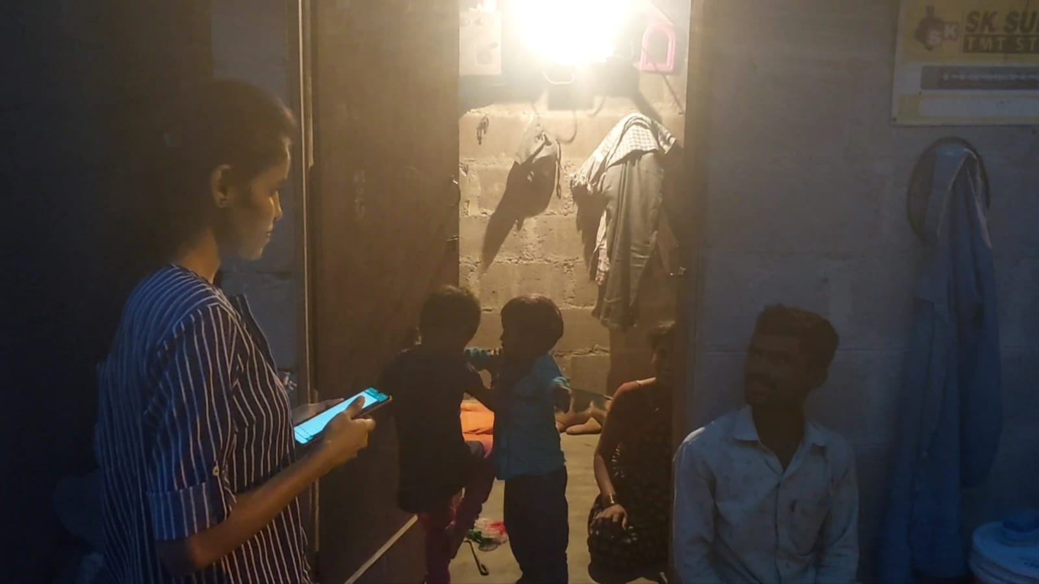

Slide 11
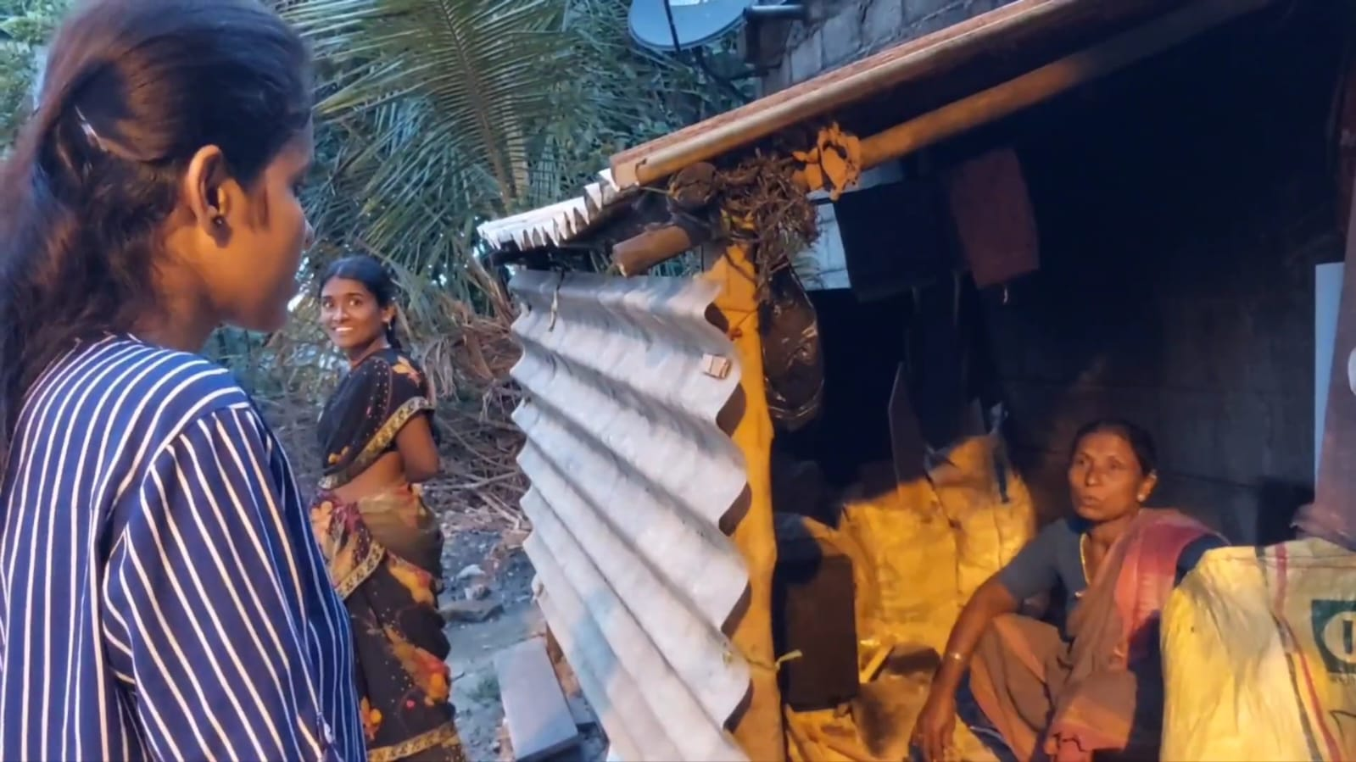

Slide 12
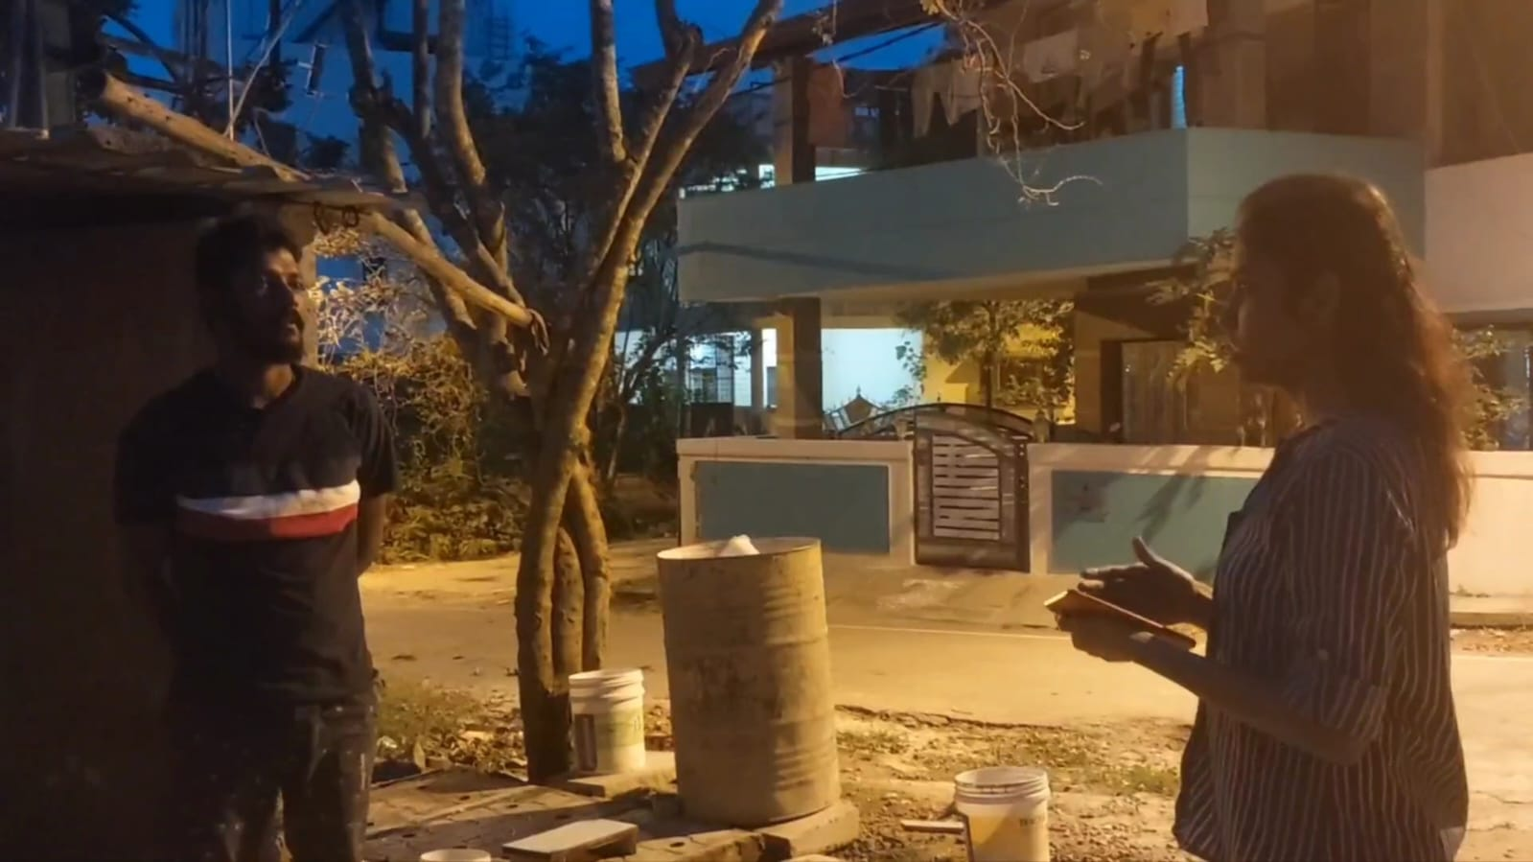

Slide 13
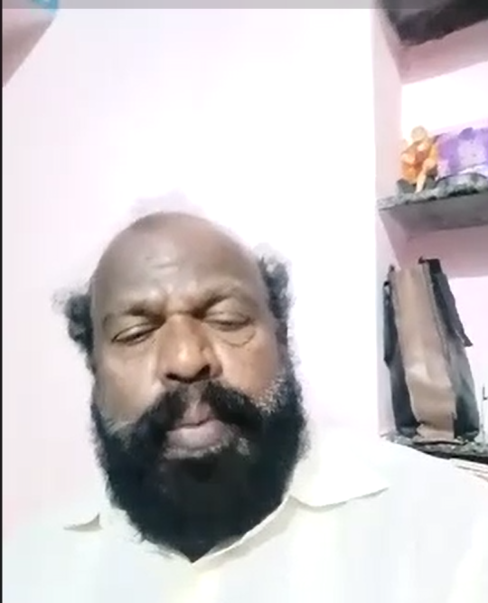
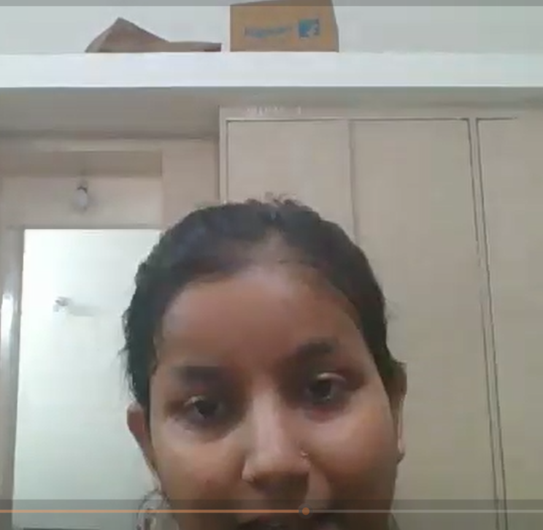
b. Personal Interview

Slide 14
c. Primary Research
What is your name?
Which state do you belong to?
What was your previous occupation?
Why did you decide to work as a labourer?
What caused you to migrate from your hometown?
What is your basic educational qualification?
How many members are there in your family?
How many children do you have?
Are your children attending school?
Are you able to fulfill your basic needs with the wages you get?
Are you aware of the policies and laws that are made for the labourers?
Are you aware of your rights as a laborer?
Do you know how to report unsafe working conditions?
Have you ever been injured on the job?
Are you aware of the safety precautions you should take while working?
Do you know how to file a complaint if you are being mistreated at work?
Have you ever experienced wage theft?
Do you know what to do if your employer is not paying you fairly?
Have you ever been denied breaks or rest periods at work?
Are you aware of your rights to take time off work?

Slide 15
21.How do you ensure your family's safety while traveling?
22.Have you ever faced discrimination based on your language?
23.Do you have access to language support services?
24.Do you have access to affordable housing near your workplace?
25.Do you have access to affordable housing near your children's school?
26.How do you ensure your safety while using public restrooms?
27.Do you have access to affordable healthcare for your family?
28.How do you ensure your safety while using public parks?
29.Do you have access to affordable legal aid for housing issues?
30.Do you have access to affordable legal aid for work-related issues?
31.Do you have access to affordable legal aid for discrimination issues?
32.Do you have access to affordable legal aid for safety issues?
33.Do you have access to affordable legal aid for health issues?
34.Do you have access to affordable legal aid for child care issues?
35.Do you have access to affordable legal aid for elder care issues?
36.Do you have access to affordable legal aid for education issues?
37.Do you have access to affordable legal aid for mental health issues?

Slide 16
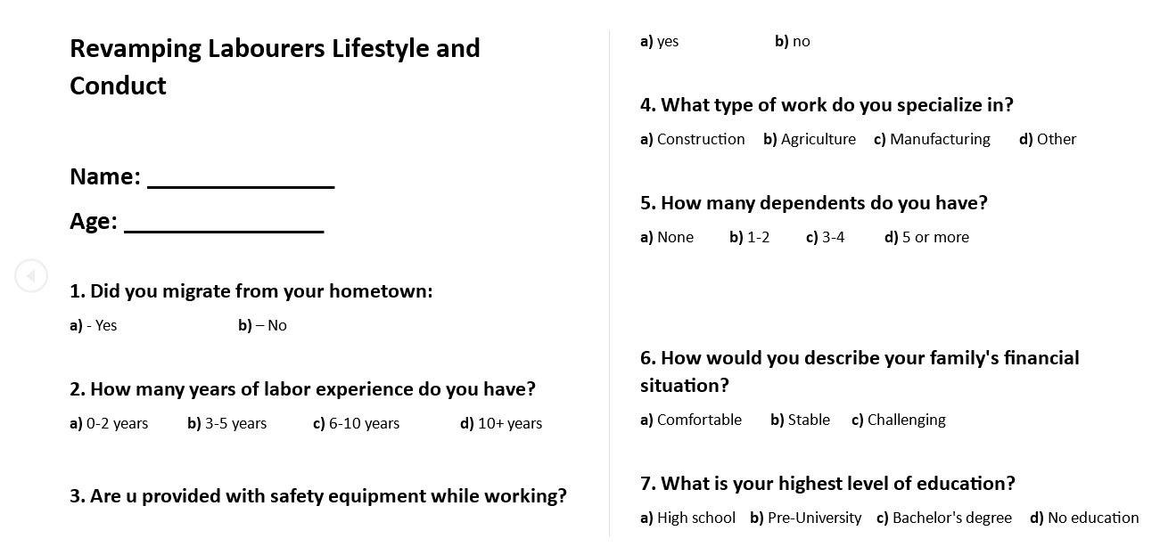
d. Questionnaire

Slide 17
